Slide 1
Digital Portfolio
STUDENT NAME: POOVARASAN P
REGISTER NO : 20724U18021
NMID: F5985F9D32tvCu82D0A772B057
DEPARTMENT: COMPUTER SCIENCE
COLLEGE: KING NANDHIVARMAN COLLEGE OF ARTS & SCIENCE
UNIVERSITY : THIRUVALLUVAR UNIVERSITY

Slide 2
DIGITAL PORTFOLIO

Slide 3


AGENDA
Problem Statement
Project Overview
End Users
Tools and Technologies
Portfolio design and Layout
Results and Screenshots
Conclusion
Github Link
3/21/2024 Annual Review

Slide 4

PROBLEM STATEMENT
The Digital Portfolio Project is based on Web Development.
This is Developed Using HTML 5, CSS and Java Script .
Text Editor (Note Pad) is used for this Project.
It Displays the Information about the Student till date, Education, Skill and Contact Details.

Slide 5

PROJECT OVERVIEW
Personal Portfolio website provides brief information about the professional background of an individual.
This project comprises of three files.
First is an HTML file for creating markup of the application on the web.
Second CSS file is used to provide more styles to the website.
Third JS file used to give a proper functionality to the application through JavaScript.

Slide 6

WHO ARE THE END USERS?
Any persons

Slide 7
TOOLS AND TECHNIQUES
HTML 5
It is the code for creating web pages, using tags and other commands that browser reads and convert in to the normal web pages that people see
CSS
CSS is the language for describing the presentation of web pages, including colours, layout and fonts
JAVA SCRIPT
Java Script is a text based programming language used both on the Client-side and Server side that allows you to make web pages interactive. It gives web pages interactive elements that engage a user.
BROWSER
It is a Software used for exploring and presenting the contents on the world wide web.T To see the actual output of the website the browsers are used. The languages like HTML, CSS and JAVA SCRIPT are compiled by the browser.

Slide 8
POTFOLIO DESIGN AND LAYOUT
Portfolio contains these Section
About - Quick Introduction about me
Education - Display my Educational Qualification
Certificates – List out the certificates
Hobbies – list my Hobbies
Details – Personal Information
Contact - end user contact me through this section
8

Slide 9
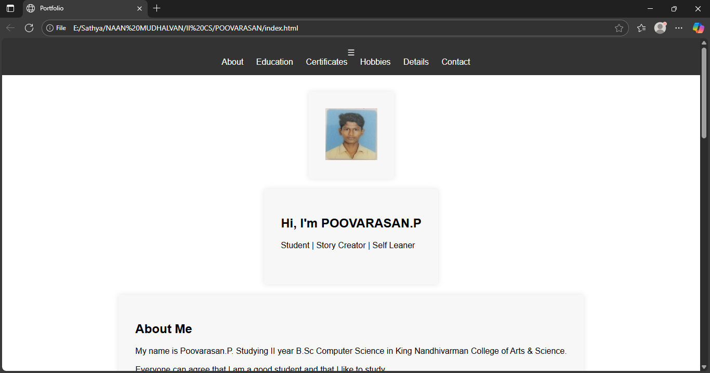
RESULTS AND SCREENSHOTS

Slide 10
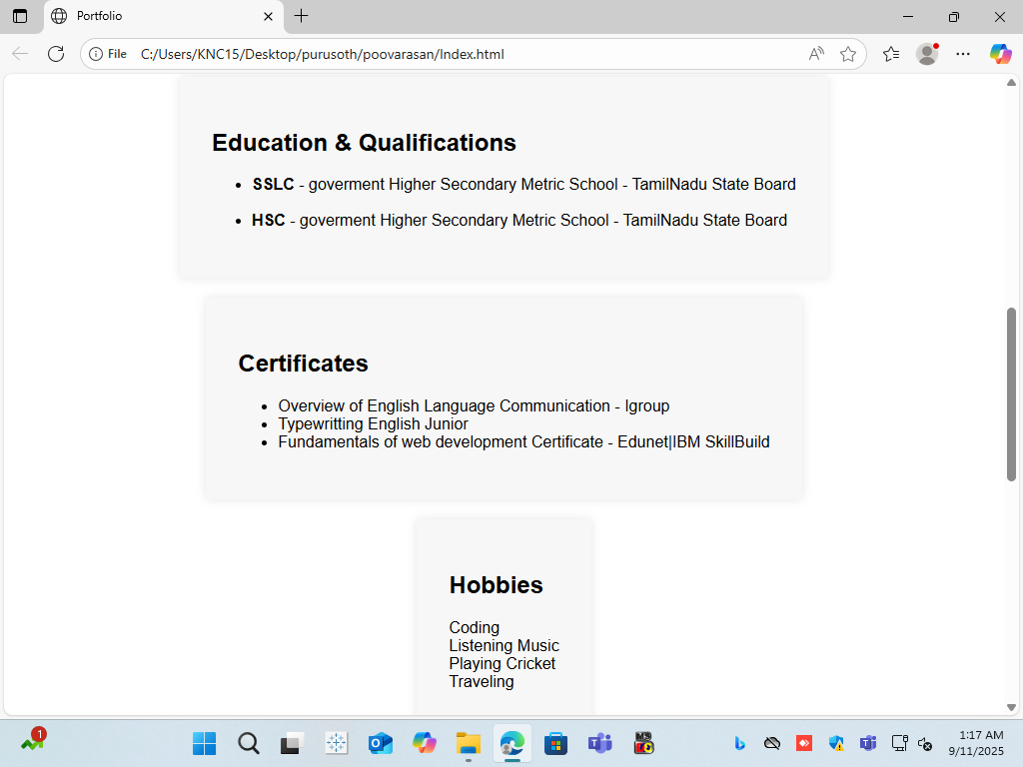

Slide 11
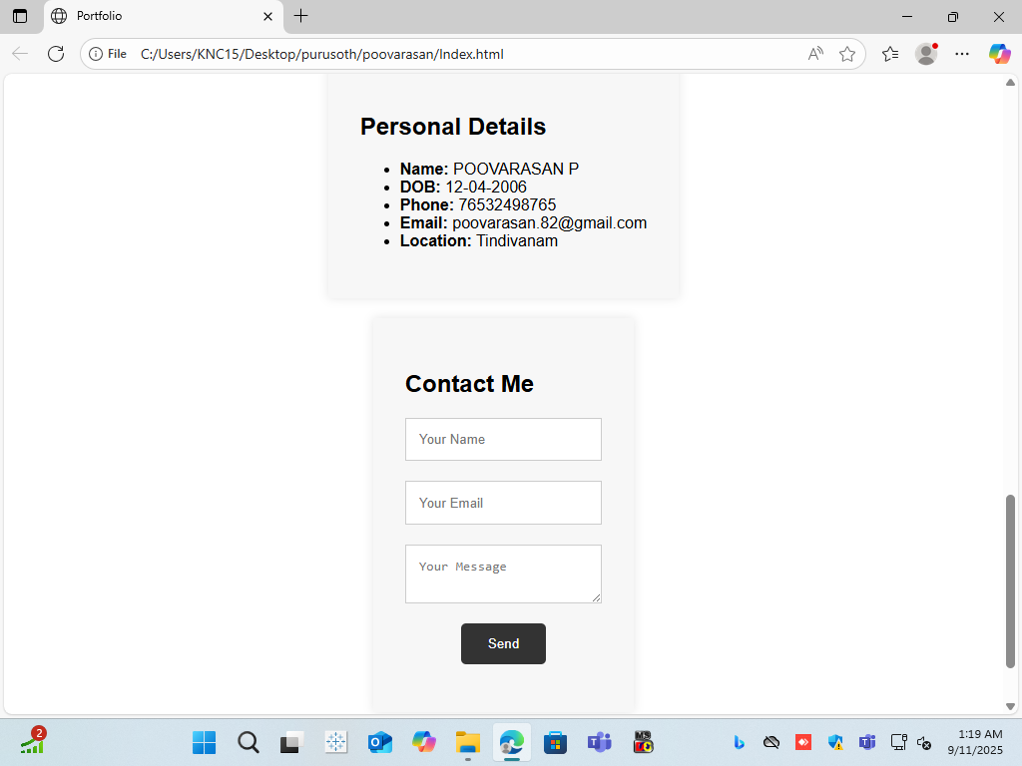

Slide 12
CONCLUSION
At last to conclude, I have developed a simple and basic Personal Digital Portfolio website using HTML 5, CSS, JAVA SCRIPT using Text Editor(NotePad) which I would continue to maintain in future too.
12

Slide 13
Github Link
https://amudha6379425562-hash.github.io/digital-portfoilio/

